Slide 1
ICT Gaming Lesson 1

Slide 2
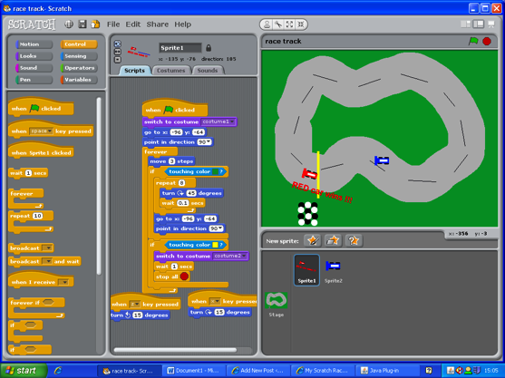
Why we play games: Objectives
Objectives
10.1.1: Describe the role of games in modern society (e.g., education, task training, social networking, therapy, recreation).
10.1.2: Identify various types of games (e.g., chance, skill, knowledge, role-playing, storytelling).

Slide 3
Lesson 1- Gaming Process
This lesson will introduce you to the principles of game design and the game creation process.
Definition: Game
In general, a game is
interactive
has a setting,
has a plot which is progressed by the actions of the player(s)
the winning player most often being rewarded through benefits and/or awards to the next stage of the plot.
Games involve problem solving

Slide 4
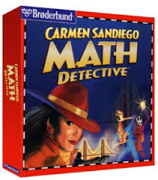
Roles of Games
Education — Games built to train or educate the player.
Task training — Games used by businesses to provide their employees with additional skills needed to perform a job. Task training is also used by the military (for example, flight simulators).
Social networking — These games include multi-player capabilities among people with common interests.

Slide 5
Roles of Games
Therapy — simulations to assist patients with the healing process.
Recreation — focus on players' movement to exercise their bodies and minds, build skills, and advance through increasing game difficulty.

Slide 6
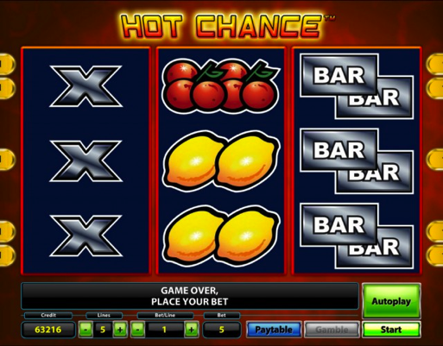
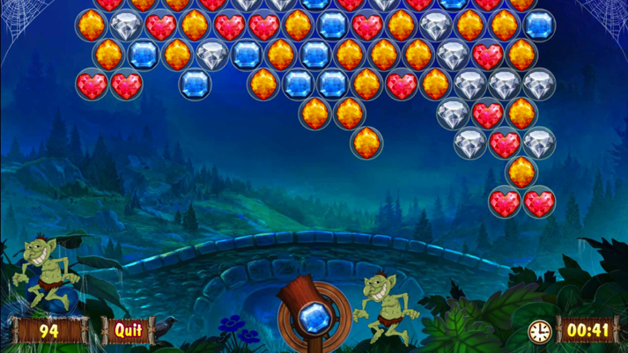
Genres
Chance — Luck or possibility plays a role in determining the outcome of the game (for example, dice, cards).
Skill — The player's skill – expertise - determines the outcome of the game.

Slide 7
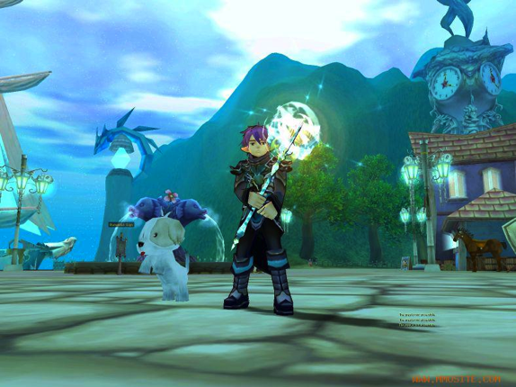
Genres
Role-playing — People assume roles of characters and act out or base decisions on their roles (for example, Dungeons & Dragons).
Video — Interaction with the game takes place in a virtual environment (for example, television, computer, handheld device).

Slide 8
Design Process: Objectives
Objectives
10.2.1: Identify the steps of the design process for creating a game.
10.2.2: Apply the design process to solving a problem.
10.2.3: Analyze (deconstruct) existing games.
10.2.4: Identify the tools and skills needed for creating games.
10.2.5: Identify design criteria and constraints.
10.2.6: Create storyboards to model a game's program flow and functionality.

Slide 9
Design Process
Games generally present some form of a challenge or problem, and the goal of playing the game is to meet the challenge or solve the problem.
Designing a game is the same as writing a story.
A story is included to add entertainment to the game.
A story must have a setting (where the game takes place), a story line or plot, and characters.

Slide 10
Steps in the Design Process
1. Brainstorm
Encourages creativity and development of unique game or solution.
Suggest spontaneous (non-rehearsed or researched) ideas and solutions.
Each idea is reviewed.
The best idea or combination of ideas is used.

Slide 11
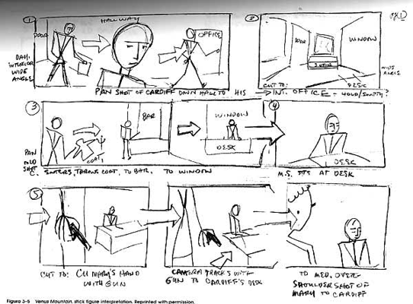
Steps in the Design Process
2. Storyboard
A storyboard is like a graphic organizer.
Uses illustrations or images displayed on a piece of paper.
Arranged in the order of the story.
Helps plan the sequence of events – every step.
A storyboard helps with identifying how the characters interact with each other and with the game environment.

Slide 12
Steps in the Design Process
3. Prototype
First functional example of a game.
Referred to as a “first draft”.
Allows people to play and test a game for the first time and offer their feedback or suggestions for improvement.

Slide 13
Steps in the Design Process
4. Testing and Feedback
It is best practice to:
Have a group of individuals test your game that is not familiar with the game or its design process.
They should have varying degrees of expertise with playing games.
Ensures feedback is not influenced by preconceived ideas about what the game is, how it should be played or how difficult it is.

Slide 14
Steps in the Design Process
4. Testing and Feedback
Feedback: suggestions and ideas for improving or refining the game or issues with playing the game.

Slide 15
Final Steps in the Design Process
Revise the game: revise (modify) game to address the suggestions and issues identified by the testing team.
Re-test and gather feedback.
Finalize the game.
Revise and re-test (if necessary).

Slide 16
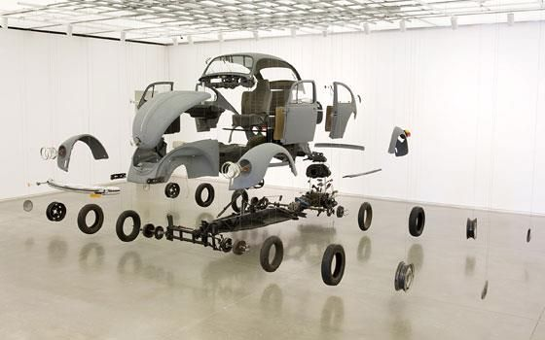
Deconstructing a Game
Deconstruct: Study an existing game and see how:
How was it built?
What elements are present?
How do the elements work together to create the game?
How does the audience interact with the game?

Slide 17
Development Tools
Computer Hardware
Desktop computers, tablets and handheld devices all work
Choose tools you feel most comfortable working with (small vs. large screen, keyboard vs. touchscreen, and so forth).
If you want to create a game that can be played on Apple computers (including iPads, iPods, and so forth.), then you usually must build it on a device using the Apple platform.

Slide 18
Development Tools
Software
Scratch — A free game-programming environment.
Game Salad — design games in a drag-and-drop environment with no coding, and publish your games as apps for iOS and Android devices.
Quest — Makes playable text-only adventure games.
Yoyo Games — Accessible yet powerful professional-level 2D and 3D game creation.
Clickteam — Game design and development tools for amateur game creators, both new and experienced.
3D Gamemaker — Create games quickly with pre-made scenes and objects.
Blender — A free 3D creation tool.
Maya (Autodesk) — Create games and 3D animations.
3DS Max (Autodesk) — Create 3D animation for games and motion graphics.

Slide 19
Software Applications
Graphic Design Software
Pixlr — A free, web-based tool used to create original images or edit existing images.
Adobe Photoshop — A well-known graphical art creation tool.
Gimp — A free open-source graphical art and simple animation tool.
Pixelmator — A Mac-based application similar to Adobe graphics tools.

Slide 20
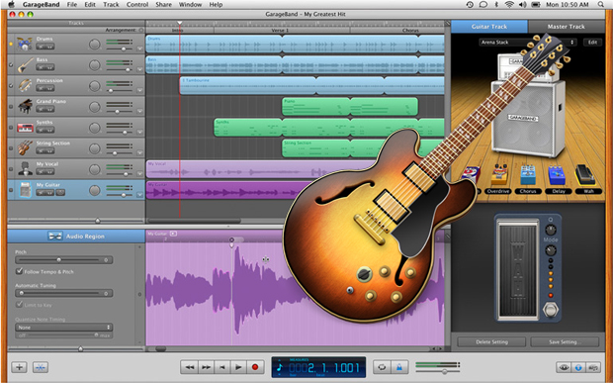
Software Applications
Audio File Creation
GarageBand — Free and inexpensive versions for creating music and sounds.
Audacity — Free basic audio recording and editing.

Slide 21
Development Tools
Team Members
Graphical artist — Video games consist of graphics in motion with a goal and a plan.
Programmer — Programming code is required to create a computer game
Music and sound effects —You can create your own sound files and incorporate them into your game

Slide 22
Development Tools
Team Members
Game Designer — They must perform several important tasks in game development, which may require the skills of more than one person:
Create the look and feel of the game.
Develop the art and animation for all graphical elements, including scenes, characters, the website, and so on.
Develop scenarios that occur between characters during play.
Write scripts and dialog for the action and characters.

Slide 23
Development Tools
Team Members
Testing team — After you develop the first version of your game, you will need to do lots of testing to see how it performs on various devices and find any bugs in the program.
Enlist the help of friends and other people to test it as well.
The best group of testers will have varying levels of gaming experience and no familiarity with your game.

Slide 24
Developing a Game
Criteria
The actions you want your characters to perform and the outcomes the players will be able to achieve by playing the game and reaching a successful solution.
Number of players.
How long the game takes to play.
The kind of actions your characters can take.
What is required to win the game.
Constraints
The issues or roadblocks the development team will face that limit the team’s ability to meet the goals it set out for the game.
The amount of money it will take to develop the game.
The abilities the artists and programmers to create the desired actions.
The tools available to you.
The amount of time allowed.

Slide 25
Criteria - Constraints

